Slide 1



Mastering GitHub Copilot
Tim Warner
Principal Author, Pluralsight
tim-warner@pluralsight.com

Slide 2
"Where da handouts at?!"
The GitHub Copilot ecosystem
How GitHub Copilot works
Prompting GitHub Copilot for success
Overview

Slide 3

Session Materials
timw.info/edo

Slide 4
The GitHub Copilot Ecosystem

Slide 5
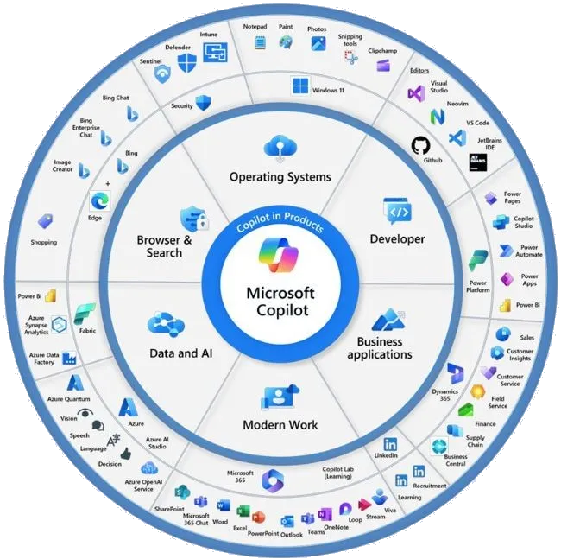
Microsoft Copilot Family
timw.info/vtz

Slide 6
How GitHub Copilot Works

Slide 7
Anatomy of a Copilot Chat Conversation
System prompt: You are a PowerShell expert.
User prompt: Write a PowerShell script that searches a directory using regular expressions to match .db files that include the dates 2004 to 2008.
Completion: To create a PowerShell script that searches a directory for .db files with dates ranging from 2004 to 2008 in their filenames, you can use regular expressions...

Slide 8
Anatomy of a Copilot Chat Conversation: Enriched
System prompt: You are a PowerShell expert whose code is always documented and adheres to contemporary security and development best practices.
User prompt: Write a PowerShell function that searches a directory given as an input parameter using regular expressions to match .db files that include the dates 2004 to 2008 inclusive. I want to invoke the function like this: find-dbfiles -directory <path or paths> Give me the output like this: Folder File Name
------ ---------
path filename.db

Slide 9
Prompting GitHub Copilot For Success

Slide 10





Copilot Prompting Tips
Goal: What response do you want from Copilot?
Context: Why do you need this information, and who's involved?
Source: Which information sources should Copilot use?
Expectations: How should Copilot respond to meet your needs?
Follow-up: Collaborate with Copilot to gain better responses

Slide 11

Questions? Comments? Curiosities?

Slide 12
Future trend to watch out for:
Custom GPTs in GitHub Copilot
Test now at chat.openai.com
Please attend one of my "Conversations" sessions today!
Thanks for hosting me - I appreciate you
Email: tim-warner@pluralsight.com
LinkedIn: timw.info/li
Summary

